Slide 1
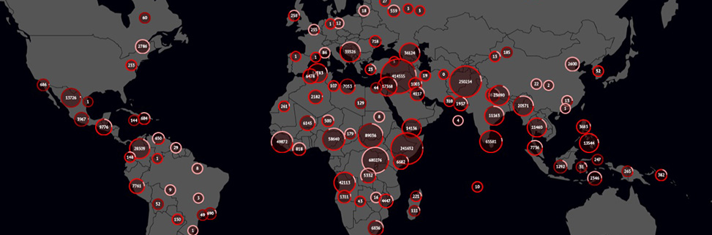
Peacekeeping Data and Predictive Peacekeeping
Allard Duursma
allard.duursma@sipo.gess.ethz.ch
@AllardDuursma

Slide 2
Overview
Where do we come from?
Where are we currently?
Where could we be going?
Notes:
-An outsider’s view

Slide 3
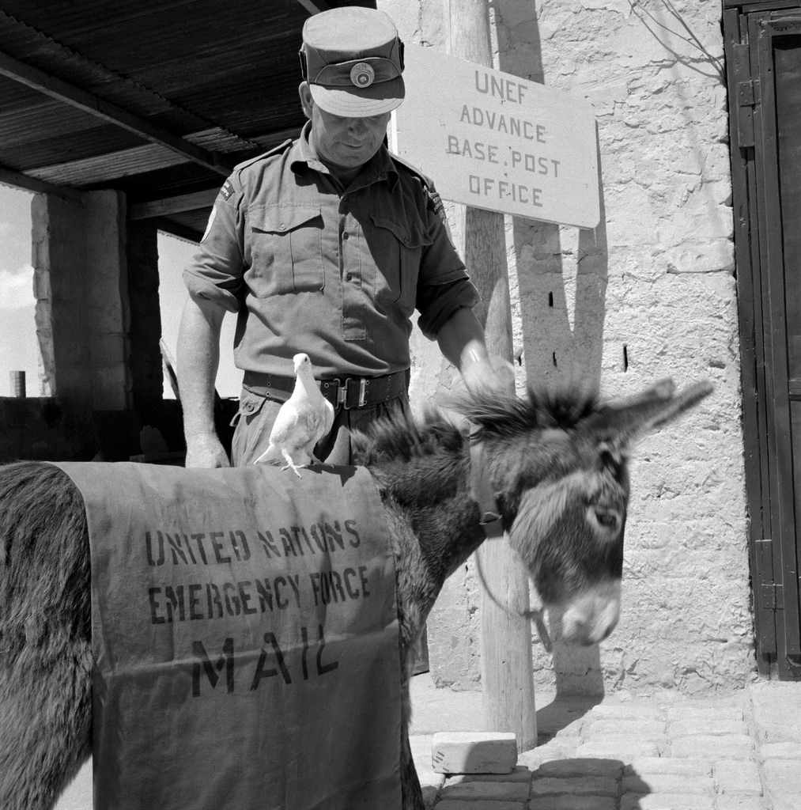
Collection and distribution of information within the UN – the early days
Notes:
See Walter paper on Congo

Slide 4
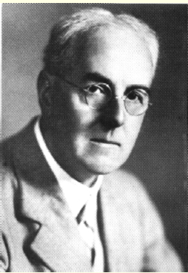
The collection of conflict data (1/2)
“There is in the world a great deal of brilliant, witty political discussion which leads to no settled convictions. My aim has been different: namely to examine a few notions by quantitative techniques in the hope of reaching a reliable answer.“ -- Lewis Fry Richardson, author of Statistics of Deadly Quarrels
Notes:
Length of border predictor
Many more small conflict in which few people die, than large scale wars in which many die

Slide 5
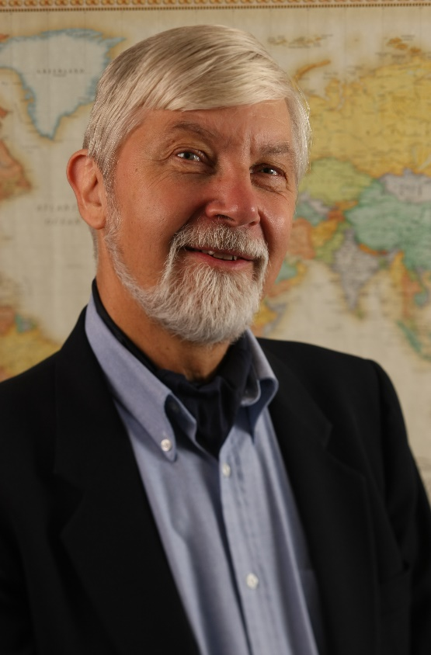
The collection of conflict data (2/2)
Peter Wallensteen, founder of the Uppsala Conflict Data Program (UCDP)
Notes:
BBC World News anecdote

Slide 6
Where are we currently?

Slide 7
JMAC
JMAC established in 2005
Peacekeeping is “a never-ending exercise in risk management and decisionmaking in an environment of uncertainty” -- Jean-Marie Guéhenno, former Under-Secretary General for UN DPKO
Increasingly data-driven – from Word documents to geo-tagged event and security datasets in Excel
Notes:
Previously a lot of resistance to intelligence initiatives, but following Iraq, a change…

Slide 8
Example of an observation…
“On 08 Jan 08, Salamat and Fallata tribesmen with vehicles, horses and camels attacked Nadhif village(33 km west of Buram), killing 40 civilians and 390 families had been looted and thereby displaced from Edd Fursan.”

Slide 9
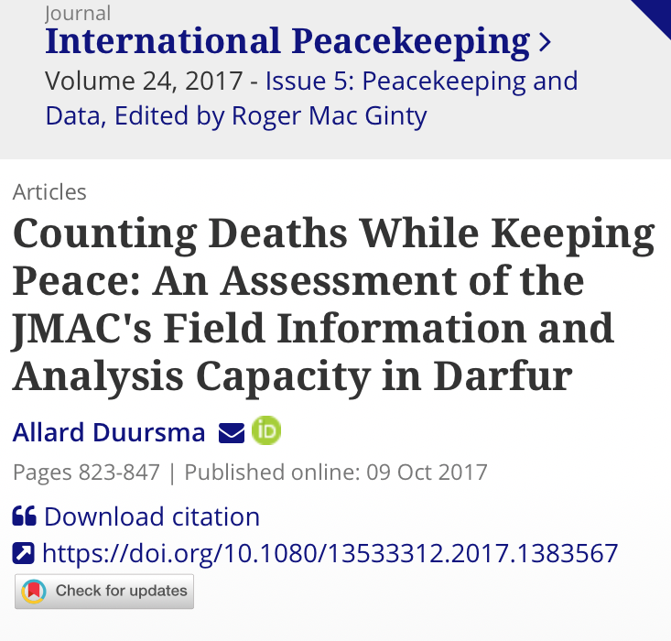
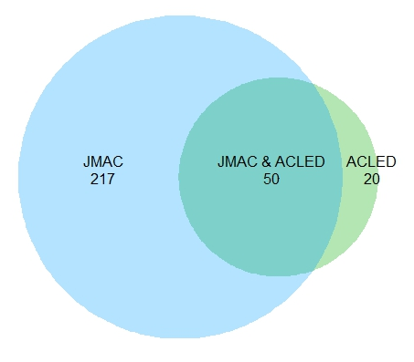
Venn Diagram of Armed Clashes Included in the JMAC and ACLED Datasets on Darfur, January 2008 – April 2009

Slide 10
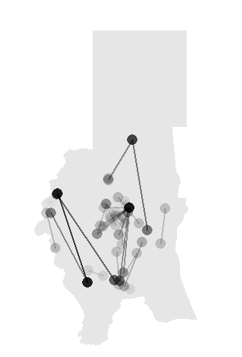
Difference between Locations of Armed Clashes Reported in both the JMAC and the ACLED Datasets
Note: The lines connect the locations of events specified in the JMAC and the ACLED datasets. Colour intensity is scaled by length, such that longer lines are more visible

Slide 11
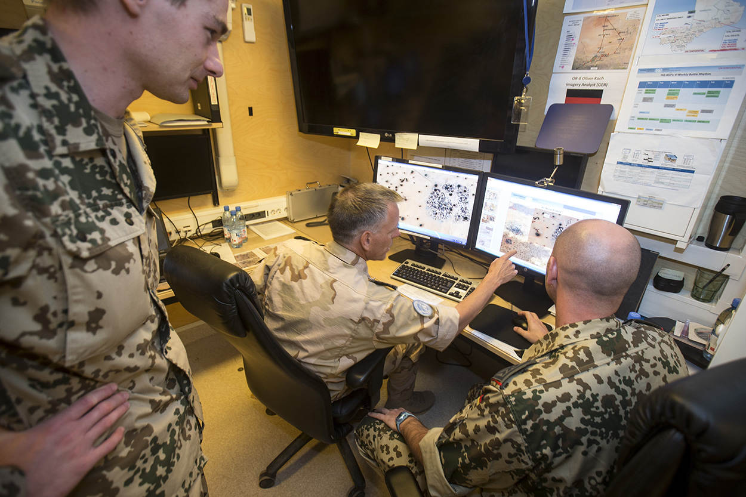
Innovations in the field
Local innovation, ad hoc and mission-driven
Image analysis
Drones
ASIFU in Mali

Slide 12
SAGE
The Situational Awareness Geospatial Enterprise
Incident and event database tool (based on Ushahidi)
  Structured data – type of event, # of victims, ethnicity, geotagged location, # and affiliation of perpetrators
  Input at field office level, corroboration at higher levels
  Computer, pad or phone input
  Lots of data
Huge step in terms of systematically collecting information and possibly systematically distributing information

Slide 13
A look into the future
SAGE could be used to explain and predict the occurrence, escalation, duration, termination, and possible spread of different types of armed violence
“New York is a black hole into which our reports descend”
  SAGE could ensure a two-way flow of information

Slide 14
Explaining and predicting: possible uses of peacekeeping data
Explaining
  Where do peacekeepers go?
  The effectiveness of mediating local conflict
  The obstruction of peacekeepers
Predicting
  Predicting armed violence

Slide 15
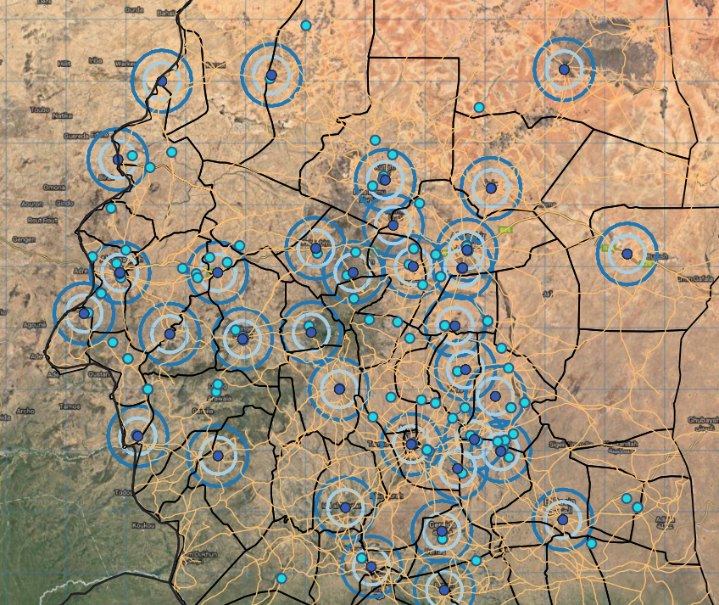

Slide 16
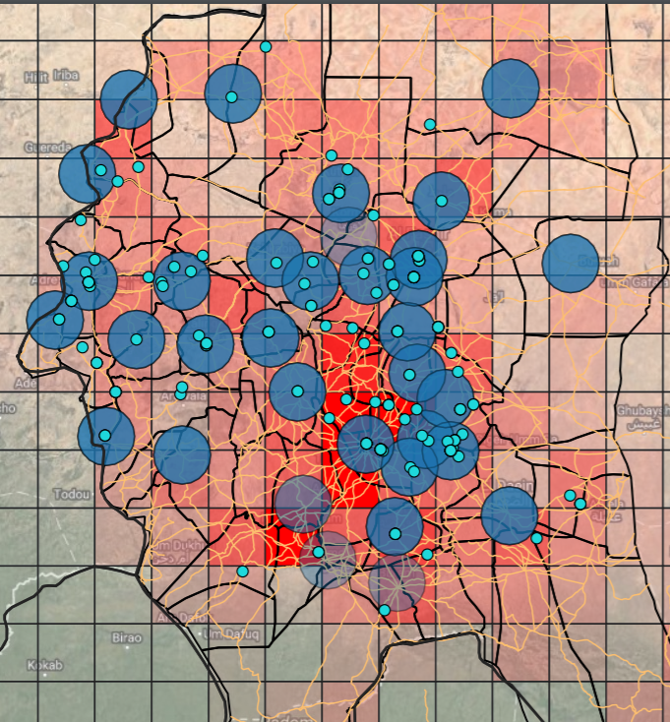

Slide 17
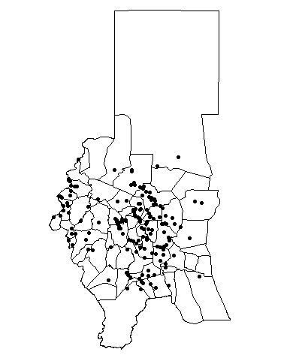
Analyzing Local Peacemaking Efforts
8 May 08: Ladob Village has been set ablaze as a result of fighting between Birgid (supported by SLA F/W) and Zaghawa (supported by SLA/MM).
15 May 2008: UNAMID forces and civilian component have been mediating the conflict that opposes the Birgit to the Zaghawa and their respective affiliated movements, the SLA FW and the SLA MM. The wali of South Darfur has also addressed the issue.

Slide 18
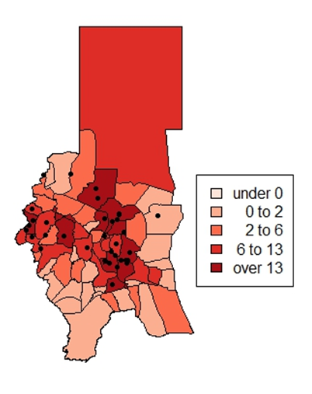
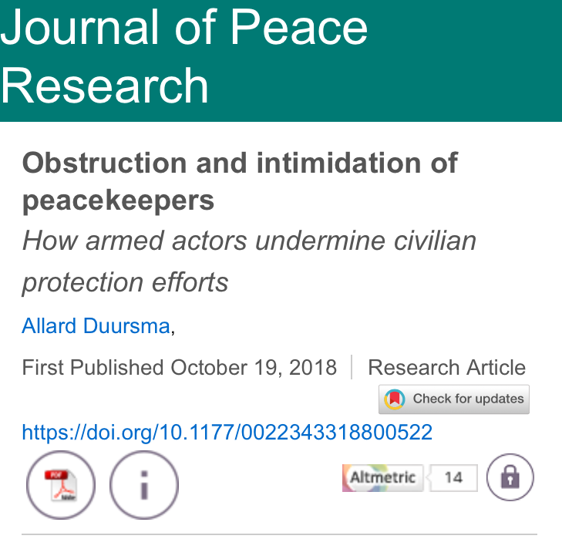
The Spatial Correlation between the Targeting of Civilians and the Obstruction and Intimidation of UNAMID in Darfur, January 2008 – March 2009

Slide 19
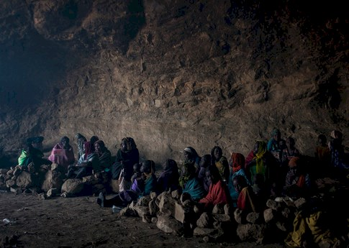
Snoopers (I)
Conflict parties that are targeting civilians do not want “snoopers” around that can collect information on human rights abuses and the targeting of civilians
  During the first half of 2016, some 250 people died in Jebel Marra as a result of the use of chemical weapons

Slide 20
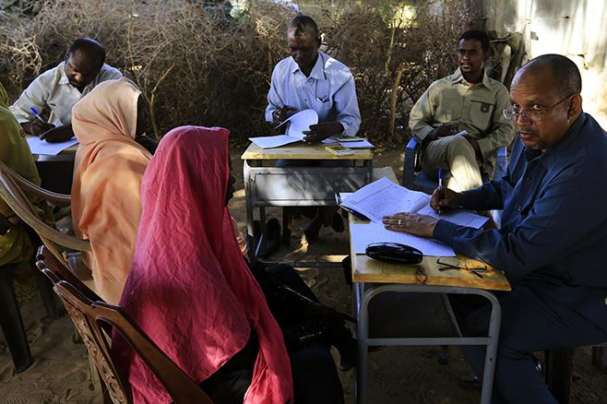
Snoopers (II)
Rape cover-up case in Tabit in October 2014
On 9 November 2014, the Government of Sudan gave peacekeepers brief access, but security forces prevented them from carrying out a credible investigation

Slide 21
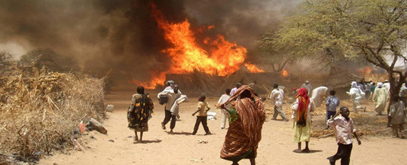
Protectors
“The AU had been attempting to deploy troops in Khor Abeche ever since an incident in which the Missirya [a Darfurian Arab tribe] accused [Minni] Minnawi [one of the Darfurian rebel leaders] fighters of stealing 150 cows and refusing to hand over the bodies of two men killed in an earlier attack. The AU and the UN accused the government of ‘deliberate procrastination’ in authorizing the African Union Mission in Sudan (AMIS) deployment despite the fact that the Nazir Tijan [an Arab militia leader] ‘had in their very presence repeatedly threatened the destruction of Khor Abeche’. While the government stalled, the militia struck, sending 350 men into Khor Abeche on horseback and camel, ‘killing, burning, and destroying everything in their paths and leaving in their wake total destruction with only the mosque and the school spared’” (Flint & de Waal, 2008: 155-156).

Slide 22
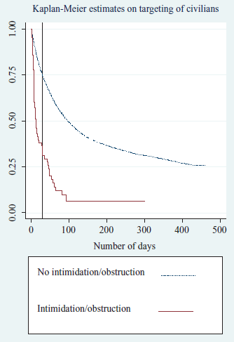

Slide 23
AI Peace?
Early warning / prediction as the holy grail
Artificial intelligence understood as machine learning
Machine learning is defined as “the automated detection of meaningful patterns in data”, Shai Shalev-Shwartz and Shai Ben-David. Understanding Machine Learning: From Theory to Algorithms. Cambridge: Cambridge University Press, 2014: p. vii.

Slide 24
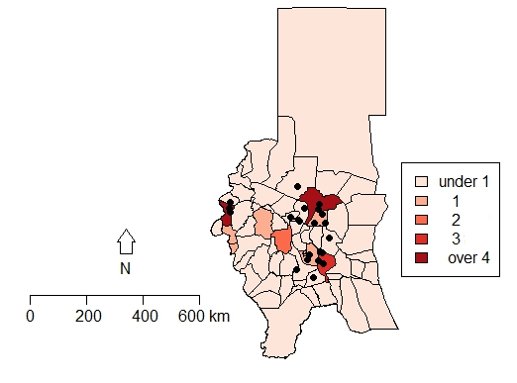
The Spatial Correlation between JMAC Reports on Tensions and the Targeting of Civilians in Darfur in January 2008
“On 20 May 08, SLA/MM stated that according to their information GoS affiliated armed groups are mobilizing with the purpose to attack several SLA/MM controlled villages, including Muhajeriya, Labado and Marla.”
Notes:
Possible to take the ‘negative cases’ into account
Possible to take the combined effect of several factors into account (e.g. tensions AND troop movements)
Systematically evaluating policy options

Slide 25
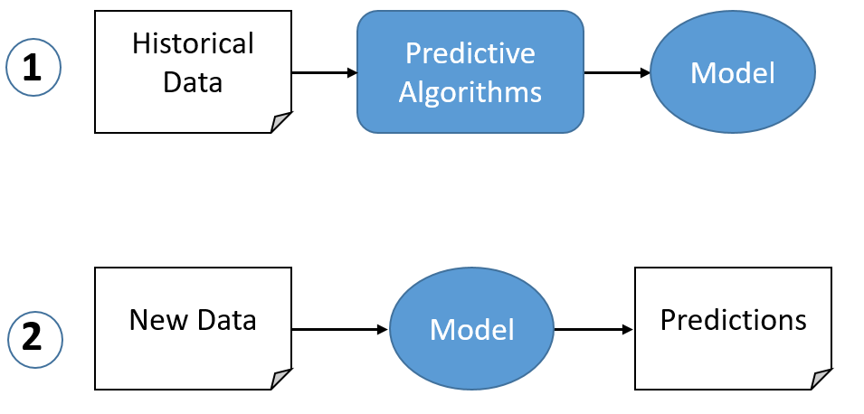
Prediction

Slide 26
Some caveats…
Garbage in, garbage out
Conflict processes are incredibly complex because they ”typically encompass an unwieldy set of actors interacting in surprising and, by definition, rule-breaking ways” (Cederman and Weidmann 2017: 475)
Level 2 chaos: chaos that reacts to predictions about it

Slide 27
Translating Early Warning into Early Action
Identifying risks to the mission
Deploying troops
Conflict prevention efforts
“Big brains, little hands?”

Slide 28
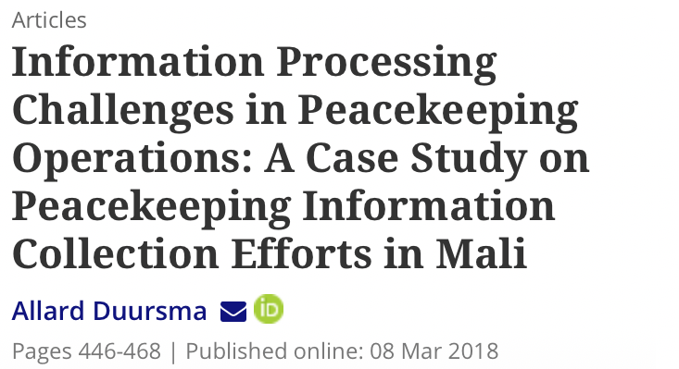
Limits of information…
 | Information | Frames of reference
Lack of… | Uncertainty | Ambiguity
Variety/diversity of… | Complexity | Equivocality

Slide 29
Cable from Kigali to New York on 8 April 1994, two days after the plane with Rwandan President Habyarimana was shot down
Head of UNAMIR Jacques-Roger Booh-Booh: “The security situation in Rwanda is somewhat worsening, but this development is mainly linked to fighting between government forces and the RPF in the northern part of Rwanda”
UNAMIR Force Commander Roméo Dallaire: “The Appearance of a very well planned, organized, deliberate and conducted campaign of terror initiated principally by the Presidential Guard since the morning after the death of the Head of State has completely reoriented the situation in Kigali.”

Slide 30
Ethical considerations
Distancing effect – ‘bunkerization’, remote management and self-help
Data storage, life-cycle, access, integrity, privacy and risk of reidentification

Slide 31

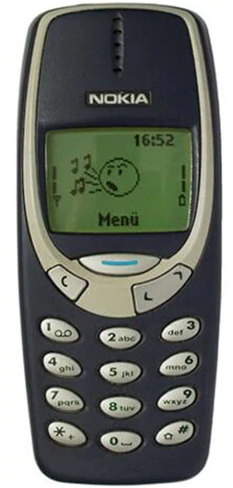
Conclusion

Slide 32
Thank you
duursma.allard@gmail.com
@AllardDuursma

